Slide 1
Comparison of ChIP-Seq Peak calling programs
Kanishk Asthana
kasthana@eng.ucsd.edu

Slide 2
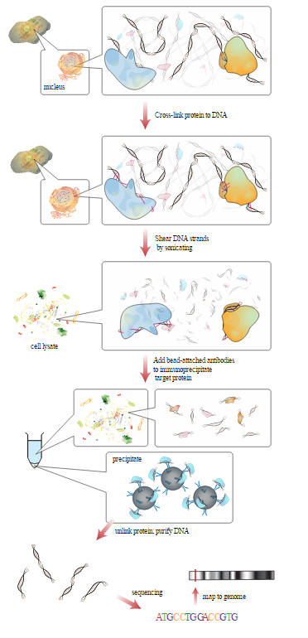
Overview of ChIP-seq
From: http://en.wikipedia.org/wiki/ChIP-sequencing#/media/File:Chromatin_immunoprecipitation_sequencing.svg

Slide 3
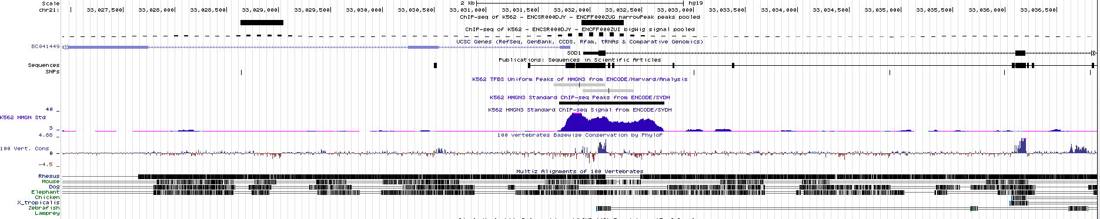
A genome wide histogram
https://www.encodeproject.org/experiments/ENCSR000DOB/

Slide 4
ChIP-seq calling programs
SISSRS: only get start position, end position and number of TAGs, no filtering method can be applied because of no score being returned.
Spp: not user friendly, documentation inadequate.
Quest: not user friendly, documentation inadequate.
PeakSeq: documentation inadequate
MACS: extremely user friendly and easy to use
HOMER: a little less user friendly, but still very useful. The entire package is what makes it so useful, a lot of associated functions and functionality.
Sole-search: documentation inadequate, not user friendly
Hpeak: only works for human genome

Slide 5
Pair wise comparison of shared peaks
Data Set | HOMER (% of Peaks shared with MACS) | MACS (% of Peaks shared with HOMER)
PU.1 | 93.24609 | 90.06348
ENCODE | 74.55422 | 89.26311
Data Set | HOMER (% of Peaks shared with SISSRS) | SISSRS (% of Peaks shared with HOMER)
PU.1 | 82.0557 | 75.01613
ENCODE | 80.47605 | 63.70693
Data Set | SISSRS (% of Peaks shared with MACS) | MACS (% of Peaks shared with SISSRS)
PU.1 | 82.8864 | 87.56901
ENCODE | 63.42505 | 95.92693

Slide 6
Comparison of HOMER vs MACS: Does more peaks called mean more false positives?
Data Set | Type of Peaks | HOMER (% of Peaks shared with MACS) | MACS (% of Peaks shared with HOMER)
PU.1 | Average | 93.24609 | 90.06348
 | Top 25 Percentile | 90.48544 | 85.42430
 | Top 5000 Peaks | 82.57576 | 80.66000
 | Bottom 25 Percentile | 57.85524 | 51.35473
ENCODE | Average | 74.55422 | 89.26311
 | Top 25 Percentile | 77.50584 | 91.39446
 | Top 5000 Peaks | 81.40521 | 80.64000
 | Bottom 25 Percentile | 24.38621 | 25.17400

Slide 7
Motif Analysis: Peaks Called by HOMER and MACS
Figure 1. PU.1 is the most ENRICHED known Motif found in peaks called by HOMER (Enrichement~44%)
Figure 2. PU.1 is the most ENRICHED known Motif found in peaks called by MACS (Enrichement~44%)

Slide 8
Motif Analysis: Peaks Called HOMER or MACS but not the other
Figure 3. PU.1 is the most ENRICHED known Motif found in peaks found in HOMER and not MACS (Enrichment ~32%)
Figure 4. PU.1 is the most ENRICHED known Motif found in peaks found in MACS and not HOMER (Enrichment ~35%)

Slide 9
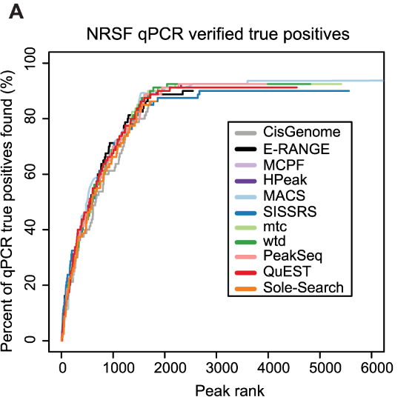
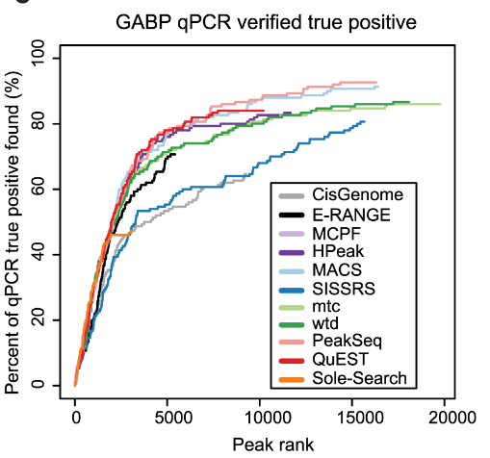
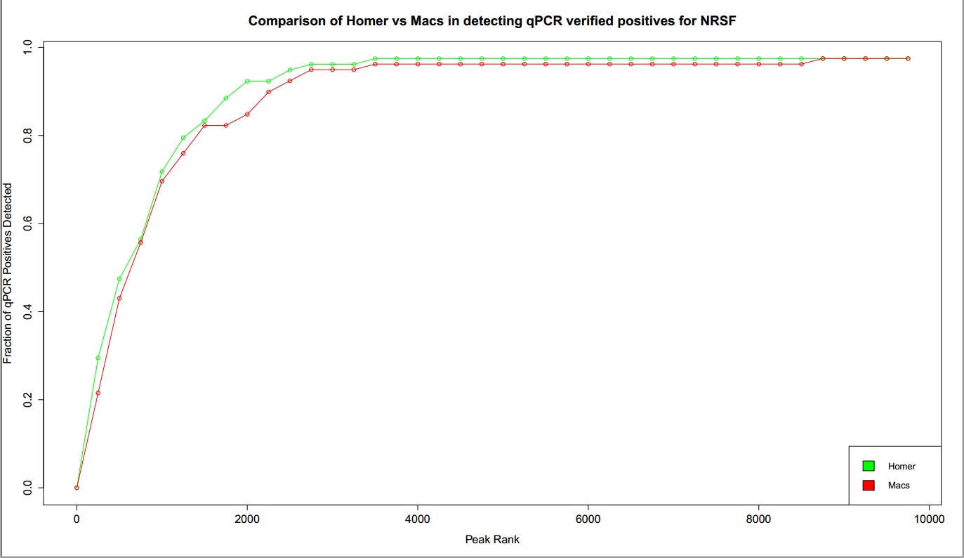
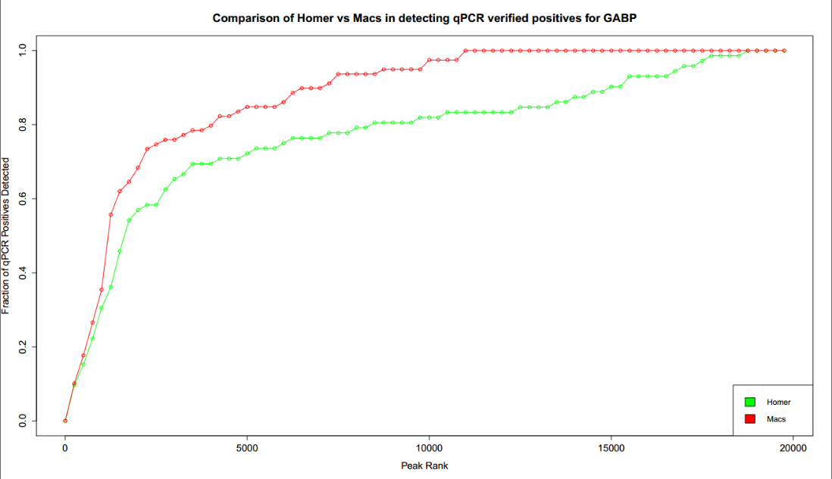
Detection of qPCR verified True Positives
Top Two figures are from Wilbanks et. al (2010) Plos One.

Slide 10
Conclusion: Which is better MACS or HOMER?
Not enough information to decide.

Slide 11
References
Wilbanks, E. G., & Facciotti, M. T. (2010). Evaluation of algorithm performance in ChIP-seq peak detection. PloS One, 5(7), e11471. doi:10.1371/journal.pone.0011471

